Slide 1




Part I
Introduction to network analysis
Jerome Baron², Shadira Gordon¹, Jose Pablo Gomez¹
¹Center for Animal Disease Modeling and Surveillance, Department of Medicine & Epidemiology, School of Veterinary Medicine, University of California, Davis
²National Veterinary Institute of Sweden, Department of Epidemiology and Disease Control
Emails: jpgo@ucdavis.edu, jerome.baron@sva.se
https://jpablo91.github.io
https://cadms.vetmed.ucdavis.edu/
Notes:
Change to new cadms website

Slide 2
Table of contents
Introduction to networks
What is a network?
Elements of a network
Data
Sources
Sampling
Static network analysis
Network simplification
Network properties
Weak and Strong component
Notes:
When describing the network charatceristics, we can describe:
General characteristics, which gives us a perspective on how the network is
Local characteristivs, which give us edge and node level information

Slide 3

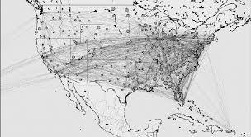
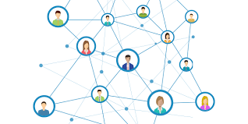
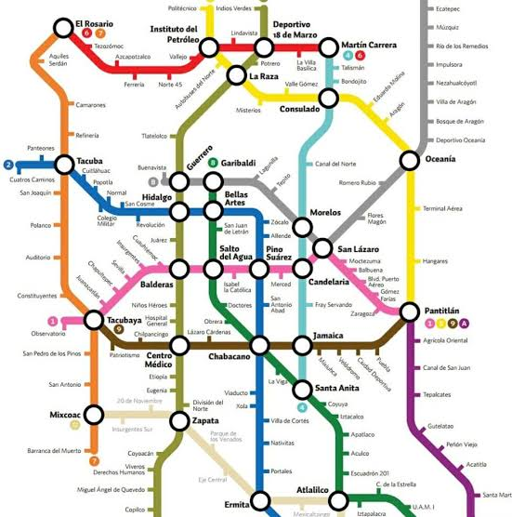
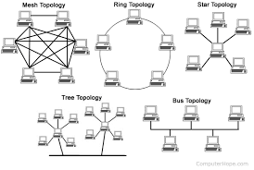
I.A - What is a network?
Notes:
A network is a representation of the interactions between the individuals in a system
Our society is a network, people have different rates of interactions with others, some have have more frequent interactions or with more people than others.
A grid of contacts or connections between individuals through physical or non-physiscal, Ephemeral vs permantent links. E.g. computers connected via internet, human social contac, hub and spoke, rail physical
Multiple applications, applied in many disciplines

Slide 4
Why represent events in a network?
To describe contact dynamics
Identify individuals that are very active
Identify individuals that are intermediate
Notes:
Identify very active individuals
If we have a disease in a population transmitted by close contacts and limited resources, where should we sample?
Identify intermediate individuals
If we want to implement some controls or surveillance measure, where should we focus it?

Slide 5
Why represent events in a network?
Model contact dynamics:
1
0
Inference: Associations between attributes and activities in a network
Prediction: Are there reproducible patterns that we can predict?
Notes:
Yellow individuals are more likely to initiate contacts than green individuals?
Is there any association between the number of contacts and some other attribute?

Slide 6
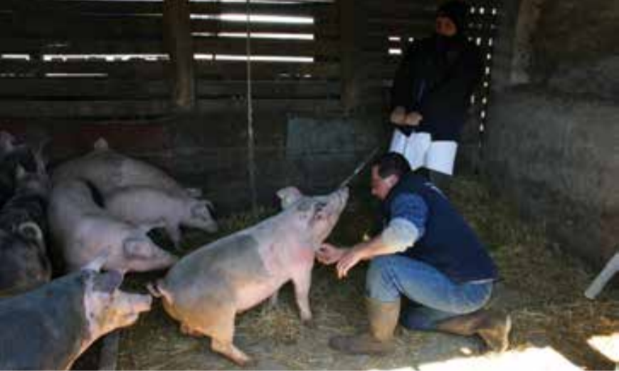
Applications in Preventative Veterinary Medicine
Uses of Networks in Preventative Veterinary Medicine
Surveillance, Prevention and Control
Identify strategic nodes for risk-based targeted intervention
Surveillance: Diagnostic testing, road checks
Pig sampling - Serbia
FAO African Swine Fever: Detection and diagnosis - 2017
Notes:
Where is most effective to sample to detect disease presence?

Slide 7
Applications in Preventative Veterinary Medicine
Uses of Networks in Preventative Veterinary Medicine
Surveillance, Prevention and Control
Identify strategic nodes for risk-based targeted intervention
Surveillance: Diagnostic testing, road checks
Prevention: Targeted vaccination, education and information campaigns

Slide 8
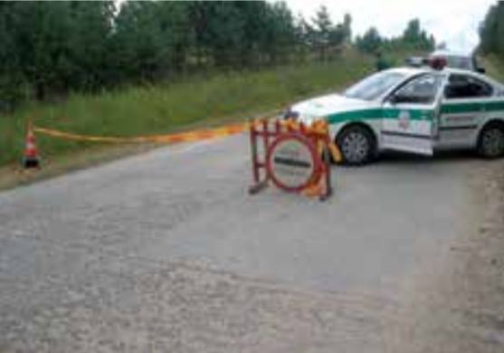
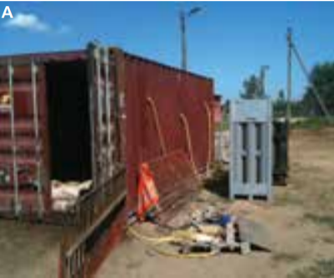
Applications in Preventative Veterinary Medicine
Uses of Networks in Preventative Veterinary Medicine
Surveillance, Prevention and Control
Identify strategic nodes for risk-based targeted intervention
Surveillance: Diagnostic testing, road checks
Prevention: Targeted vaccination, education and information campaigns
Control: Vaccination, treatment, culling campaigns, movement restrictions
Road blocks and CO2 culling chamber - Lithuania
FAO African Swine Fever: Detection and diagnosis - 2017

Slide 9
Applications in Preventative Veterinary Medicine
Uses of Networks in Preventative Veterinary Medicine
Surveillance, Prevention and Control
Identify strategic nodes for risk-based targeted intervention
Surveillance: Diagnostic testing, road checks
Prevention: Targeted vaccination, education and information campaigns
Control: Vaccination, treatment, culling campaigns, movement restrictions
Modelling of disease introduction and spread
P = ?
P = ?
P = ?
P = ?
P = ?
Notes:
When predictable patterns are detected, models probaility of contact between indviduals, and probability of transmission during a contact.

Slide 10
Applications in Preventative Veterinary Medicine
Uses of Networks in Preventative Veterinary Medicine
Surveillance, Prevention and Control
Identify strategic nodes for risk-based targeted intervention
Surveillance: Diagnostic testing, road checks
Prevention: Targeted vaccination, education and information campaigns
Control: Vaccination, treatment, culling campaigns, movement restrictions
Modelling of disease introduction and spread
Risk Factor Analysis
Notes:
risk factors of contacts, Using network metrics as predictors of transmission in regression models or using node/edge attribute as predictors of contact metrics

Slide 11
Applications in Preventative Veterinary Medicine
Uses of Networks in Preventative Veterinary Medicine
Surveillance, Prevention and Control
Identify strategic nodes for risk-based targeted intervention
Surveillance: Diagnostic testing, road checks
Prevention: Targeted vaccination, education and information campaigns
Control: Vaccination, treatment, culling campaigns, movement restrictions
Modelling of disease introduction and spread
Risk Factor Analysis
Outbreak investigation
Traceability of the outbreak’s origin and contact tracing
?
?
?
?

Slide 12
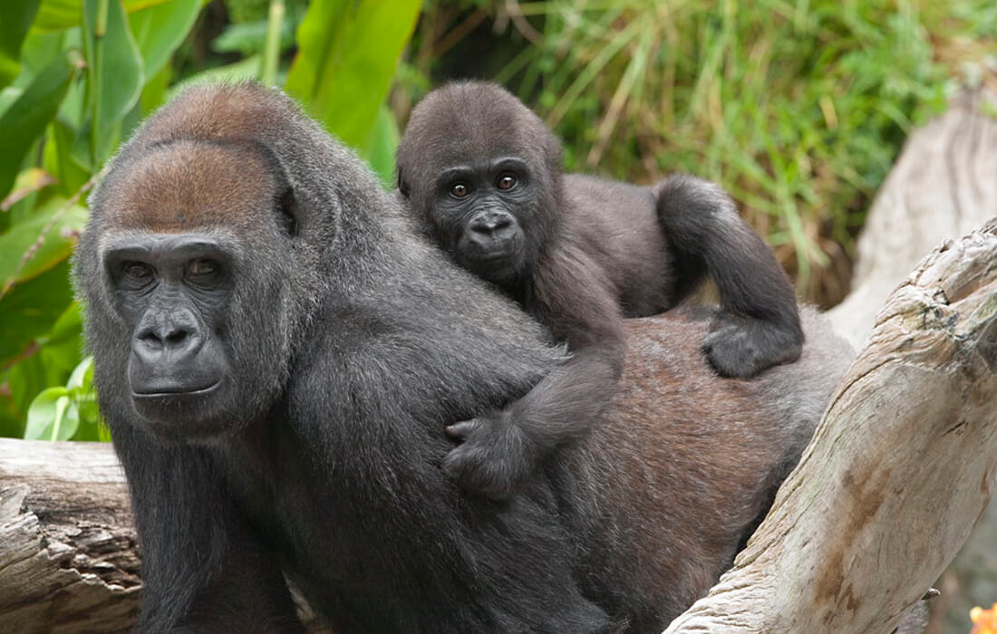
Applications in Preventative Veterinary Medicine
Uses of Networks in Preventative Veterinary Medicine
Surveillance, Prevention and Control
Identify strategic nodes for risk-based targeted intervention
Surveillance: Diagnostic testing, road checks
Prevention: Targeted vaccination, education and information campaigns
Control: Vaccination, treatment, culling campaigns, movement restrictions
Modelling of disease introduction and spread
Risk Factor Analysis
Outbreak investigation
Traceability of the outbreak’s origin
Other uses in the animal world
Behavioral studies in social animals: i.e. contact patterns in a herd of cattle, primate behavioral studies
Source: San Diego Zoo

Slide 13
Applications in Preventative Veterinary Medicine
Uses of Networks in Preventative Veterinary Medicine
Surveillance, Prevention and Control
Identify strategic nodes for risk-based targeted intervention
Surveillance: Diagnostic testing, road checks
Prevention: Targeted vaccination, education and information campaigns
Control: Vaccination, treatment, culling campaigns, movement restrictions
Modelling of disease introduction and spread
Risk Factor Analysis
Outbreak investigation
Traceability of the outbreak’s origin
Other uses in the animal world
Behavioral studies in social animals: i.e. contact patterns in a herd of cattle, primate behavioral studies

Slide 14
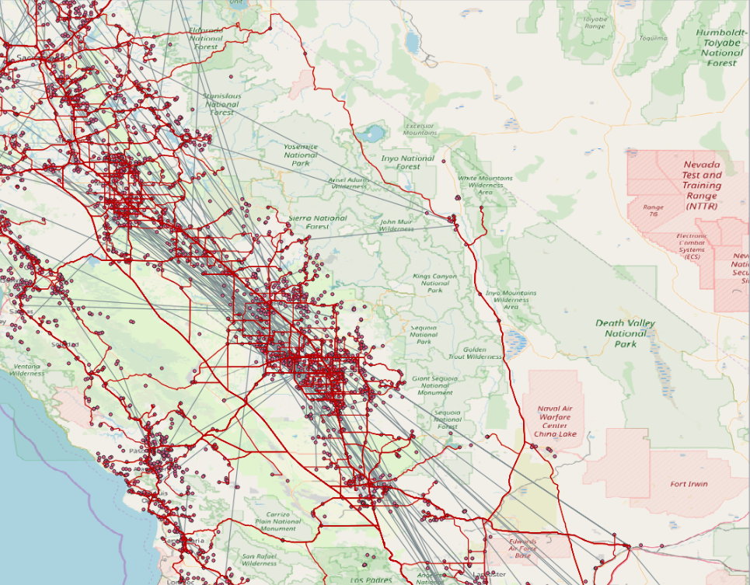
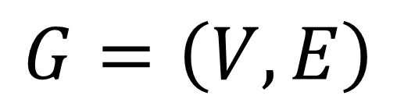
Graph theory
What is a graph? (in the context of network analysis)
“Mathematical repesentation of a network”
$$G=\left(V,E\right)$$
Where:
V = Vertice
E = Edge
Notes:
Social network analysis is applied in many areas and there are many different names for the same terms.

Slide 15
I.B - Elements of a network
Nodes (vertices)
Agents or individuals forming a network
V = {1, 2, 3, … , i}

Slide 16
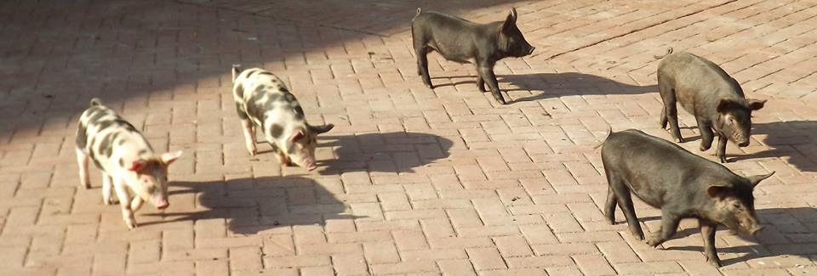
I.B - Elements of a network
Nodes (vertices)
Agents or individuals forming a network:
farms, animals, humans, markets
V = {1, 2, 3, … , i}

Slide 17
I.B - Elements of a network
Edges (links, contacts)
Connection between a pair of nodes (dyad)
E = {(1, 2), (1, 3), … , (i, j)}
In a network, connected nodes are considered as neighbours
Each of the connected nodes belongs to a neighborhood

Slide 18
I.B - Elements of a network
Edges (links, contacts)
Connection between a pair of nodes (dyad):
Animal shipments, human movements, social contacts
E = {(1, 2), (1, 3), … , (i, j)}
In a network, connected nodes are considered as neighbours
Each of the connected nodes belongs to a neighborhood

Slide 19
I.B - Elements of a network
Representation and Directionality
E = {(1→2), (3→2), … , (i →j), ..., (11 → 8)}
7
9
 | 1 | 2 | 3 | …. | J | … | 11
1 | 0 | 1 | 0 | … | 0 | … | 0
2 | 0 | 0 | 0 | … | 0 | … | 0
3 | 0 | 1 | 0 | … | 0 | … | 0
…. | … | … | … | … | … | … | …
I | 0 | 0 | 0 | … | 1 | … | 0
… | … | … | … | … | … | … | …
11 | 0 | 0 | 0 | … | 0 | … | 0
2
3
6
8
1
4
10
11
5
Notes:
Has an origin and destination
example trade vs social contact vs dog bite
A network can be addressed or non-addressed depending on the type of relationship between the pairs of nodes.
In non-addressed networks, the relationship between nodes can be in any direction.
In addressed networks there is a source and destination, which explains the direction of the relationship.

Slide 20
I.B - Elements of a network
Atributes
Nodes: farm size, type…
Edges: movement size, cause…
1
V = {0, 1, 0, … , i}
0
E = {(1), (3), … , (x_{i})}

Slide 21
I.C.a - Data sources
Define nodes:
What is the unit of analysis (e.g. farm, animal, etc)
Define edges:
Frequency of contacts
Duration of contacts
Notes:
How good is our reporting system?
How much of an impact will sub-notifications have? (regions with lower rate of reports).

Slide 22
I.C.a - Data structure
Nodes dataset
ID | Farm | Farm size | Farm type
1 | Swine and company | 800 | fattening farm
2 | Les Cochonets | 1200 | sow farm
3 | The farmhouse | 50 | small-scale farm
4 | The Boar | 20 | reproductive males
5 | Ham & sausage | 65 | slaughterhouse
6 | The trading post | 0 | market
Edges dataset
ID_origin | ID_destination | Shipment size | Date | Reason
2 | 6 | 10 | 02-25-2018 | Sale of adult sows
2 | 1 | 15 | 03-12-2018 | Piglets for fattening
4 | 1 | 1 | 10-15-2017 | Insemination
1 | 5 | 100 | 06-30-2018 | Slaughter
6 | 3 | 2 | 07-10-2018 | Sale of adult sows
2 | 1 | 100 | 02-15-2018 | Piglets for fattening
Notes:
Spatial coordinates

Slide 23
Measurement of contacts
Retrospective
National movement records
Farm registry and population census
Surveys
Prospective
Visual observation
Tracking with GPS or PIT (Passive Integrated Transporter) systems

Slide 24
I.C.a - Data sources
Passive Surveillance
Mandatory movement registries
Population census
GPS data (entire population)
Complete network
Notes:
How good is our reporting system?
How much of an impact will sub-notifications have? (regions with lower rate of reports).

Slide 25
I.C.a - Data sources
Passive Surveillance
Mandatory movement registries
Population census
GPS data (entire population)
Complete network
Impact of underreporting
Notes:
How good is our reporting system?
How much of an impact will sub-notifications have? (regions with lower rate of reports).
Question of census resolution

Slide 26
I.C.a - Data sources
Active surveillance
Surveys
Observation of a sample of the population
Subgraph sampling and incomplete network

Slide 27
I.C.b - Sampling method
Random Sampling Methods
Node induced
Sample a group of nodes
Identify all contacts between these nodes
Edge induced
Sample a group of edges
Identify all nodes connected to these edges

Slide 28
I.C.b - Sampling method
Egocentric Sampling
Sample a group 1 of nodes
Identify all contacts linked members of group 1
Identify all nodes (group 2) directly connected to group 1
Identify all contacts between members of group 2

Slide 29
I.C.b - Sampling method
Link-tracing
(respondent driven sampling)
We follow a node of specific interests and record its previous contacts
Similar to Snowball sampling
Notes:
Typically used in outbreak investigation (contact tracing) – retracing source or identifying potential subsequent contaminations

Slide 30
Table of contents
Introduction to networks
What is a network?
Elements of a network
Data sources and Sampling methods
Static network analysis
Network simplification
Network properties
General properties
Local properties
Weak and Strong component
Notes:
When we describe the characteristics of the network, we can describe:
General characteristics, which will give us a general perspective of how the network is
Local characteristics, which will give us information at the node or edge level

Slide 31
Static Network Analysis
Static Network Analysis
Network Type
Dynamic Network
Static Network
Time = t1
t3
t2
Time = t2
t3
t1
t3
t1
t2
Time = t3
t2
t1
Time = t4

Slide 32
Why use a static network?
Static Network Analysis
Simplicity of use
If data resolution isn’t high enough.
If there are technological (computational) limitations.
Simplicity of interpretation
More generalizable for predictions.
Are we interested in an ”average population” network?
Are the dynamics repeatable patterns?
Notes:
In theory, dynamic network is better than static, but...
If repeatable general average population info is of interest (especially when dynamics are not repeatable)
If goal is future prevention, dynamics are interesting if they will repeat themselves (if the predict future possible contacts)
=> But maybe an order of contact today might change tomorrow, or next month.
If goal is retrospective outbreak investigation, then dynamics is better, repeatable or not.
T1 B -> C
T2 A -> B

Slide 33
II.A - Network simplification
Network Simplification
Loops
Are they important?
Multiple Edges
Meaning? Social/Commercial relationship? Useful for modeling?
Directed or undirected
Is it relevant to disease transmission in a given context: direct animal contact vs shipment
Notes:
Multiple edges can inflate certain metrics

Slide 34
II.B - Network properties
General properties
Local properties
Notes:
When we describe the characteristics of the network, we can describe:
General characteristics, which will give us a general perspective of how the network is
Local characteristics, which will give us information at the node or edge level

Slide 35
II.B.a - General properties
Size
Diameter
Average path length
Density
Fragmentation
Clustering Coefficient

Slide 36
II.B.a - General properties
Size: Number of nodes in the network (1 to ∞)
Diameter: The shortest path between the most distant nodes (1 to ∞)
Average path length: Average length of shortest paths between every pair of nodes (1 to ∞)
Notes:
The size of the network is defined by the number of nodes in the network.
The diameter is the shortest path between

Slide 37
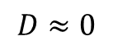
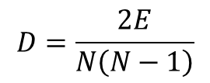
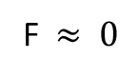
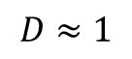
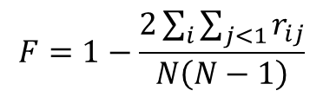
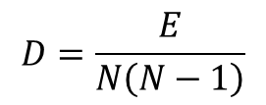
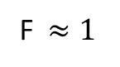
II.B.a - General properties
Density: Proportion of observed edges in network to all theoretical edges that could exist (0 to 1).
Fragmentation: Proportion of pairs of nodes that are not connected to each other (0 to 1). High fragmentation means more isolated nodes
$$D=\frac{E}{N\left(N−1\right)}$$
$$D=\frac{2E}{N\left(N−1\right)}$$
$$F=1−\frac{2\sum_{i}{\sum_{j<1}{r_{ij}}}}{N\left(N−1\right)}$$
$$D≈1$$
$$D≈0$$
F$≈ 0$
F$≈1$
Notes:
There is a relationship between D and F, Highly connected networks will have higher density and less fragmentation, poorly connected networks will have higher fragmentation and lower density.

Slide 38
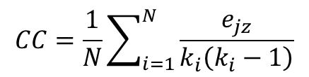
II.B.a - General properties
Clustering coefficient: The probability of individual nodes being connected
Values of 1 indicates that all nodes are directly connected to all others. Value of 0 indicates absence of contacts.
$$CC=\frac{1}{N}\sum_{i=1}^{N}{\frac{e_{jz}}{k_{i}\left(k_{i}−1\right)}}$$
Notes:
e_jz: number of nodes connecting node j and z, which are neighbours of node I
K_i degree of node i

Slide 39
II.B - Network properties
General properties
Local properties
Notes:
When we describe the characteristics of the network, we can describe:
General characteristics, which will give us a general perspective of how the network is
Local characteristics, which will give us information at the node or edge level

Slide 40
II.B.b - Local properties
Connection measures:
Path length
Geodesic distance
Farness

Slide 41
II.B.b - Local properties
Path length Number of steps to get from node i to node j
Geodesic distance The shortest path length
3
i
j
1
Notes:
Most simple and intuitive, but not always most useful because…
Covid example at home

Slide 42
II.B.b - Local properties
Farness Sum of the shortest paths (in or out)
outF = 1+2+3+3+1+2 = 12
i
Notes:
Most simple and intuitive, but not always most useful because…
Covid example at home

Slide 43
II.B.b - Local properties
Centrality measures:
Degree
Betwenness
Closeness

Slide 44
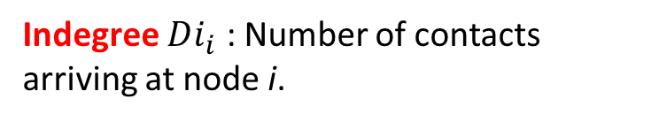
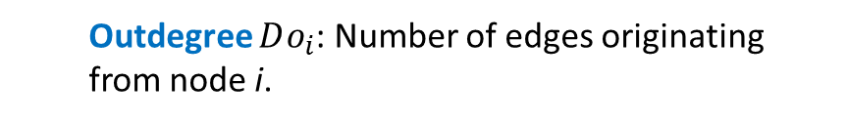
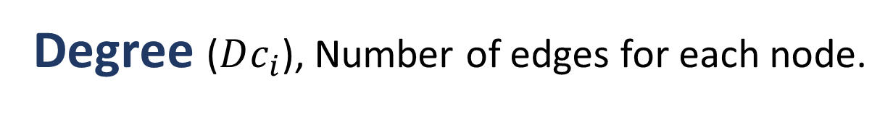
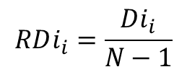
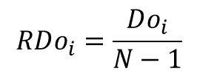
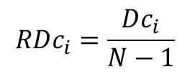
II.B.b - Local properties
Degree ($Dc_{i}$), Number of edges for each node.
Outdegree $Do_{i}$: Number of edges originating from node i.
Indegree $Di_{i}$ : Number of contacts arriving at node i.
Relative degree centrality
Outdegree = 3
$$RDc_{i}=\frac{Dc_{i}}{N−1}$$
$$RDi_{i}=\frac{Di_{i}}{N−1}$$
Indegree = 3
$$RDo_{i}=\frac{Do_{i}}{N−1}$$
Notes:
Most simple and intuitive, but not always most useful because…
Covid example at home

Slide 45
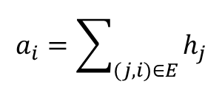
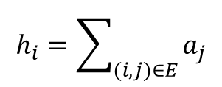
II.B.b - Local properties
Hubs and Authorities are nodes with high outedgree and high indegree.
Authority
Hub score
Authority score
$$a_{i}=\sum_{(j,i)∈E}{h_{j}}$$
$$h_{i}=\sum_{(i,j)∈E}{a_{j}}$$
Hub
Notes:
Expansion on the indegree and outdegree
A strong hub is connected to authoritative nodes
A strong authority is connected strong hub nodes
Mutually reinforcing
In disease control, authority is a good place for surveillance (as reveives a lot of contacts) and a hub is good for disease control (as it spreads a lot)

Slide 46
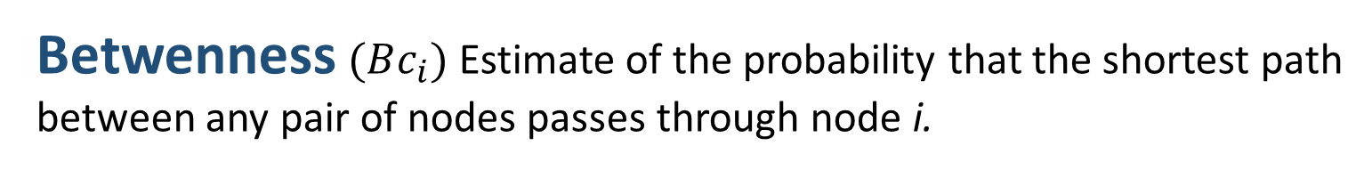
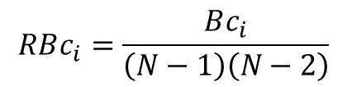
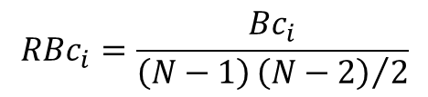
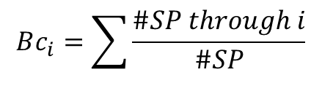
II.B.b - Local properties
Betwenness $(Bc_{i})$ Estimate of the probability that the shortest path between any pair of nodes passes through node i.
$$Bc_{i}=\sum{\frac{\#SP through i}{\#SP}}$$
Relative betweenness centrality
For non-directed networks
$$RBc_{i}=\frac{Bc_{i}}{\left(N−1\right){\left(N−2\right)}/2}$$
For directed networks
$$RBc_{i}=\frac{Bc_{i}}{\left(N−1\right)\left(N−2\right)}$$

Slide 47
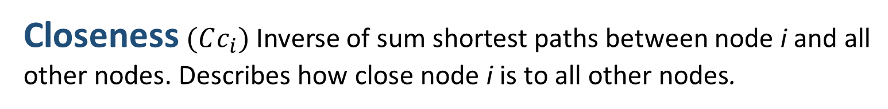
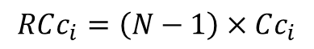
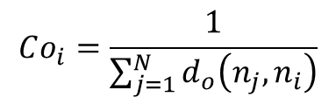
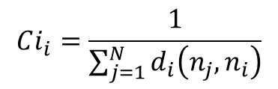
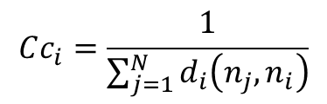
II.B.b - Local properties
Closeness$(Cc_{i})$ Inverse of sum shortest paths between node i and all other nodes. Describes how close node i is to all other nodes.
Non-directed networks:
Relative closeness centrality
$$Cc_{i}=\frac{1}{\sum_{j=1}^{N}{d_{i}\left(n_{j},n_{i}\right)}}$$
$$RCc_{i}=\left(N−1\right)×Cc_{i}$$
Directed networks:
In-closeness
Out-closeness
1 c
1 + 1 + 1 + 2
$$Ci_{i}=\frac{1}{\sum_{j=1}^{N}{d_{i}\left(n_{j},n_{i}\right)}}$$
$$Co_{i}=\frac{1}{\sum_{j=1}^{N}{d_{o}\left(n_{j},n_{i}\right)}}$$
1 c
1 + 2 + 2 + 3
Notes:
Inverse of farness
d(n_i, n_j) number of nodes in the network

Slide 48
II.C – Components and communities
Strong Component
A subset of the network in which any pair of nodes i and j can can directly reach each other
Weak Component
A subset of the network in which any pair of nodes i and j can can indirectly reach each other
Notes:
Practical application: if a disease is introduced into a strong component node, it is more likely to spread through the population.

Slide 49
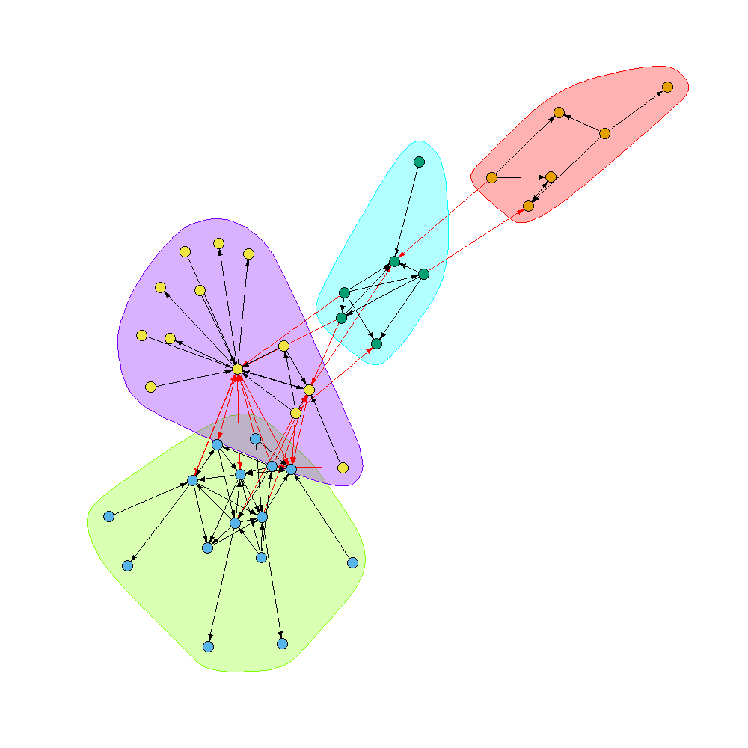
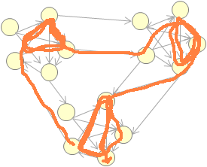
II.C - Components and communities
Communities: Many intra-community contacts and few inter-community contacts
There are many algorithms to detect communities, walktrap being one of the most popular.
I generates random paths between nodes to detect zones where it circulates more frequently within a group of nodes.
Notes:
Practical application: if a disease is introduced into a strong component node, it is more likely to spread through the population.

Slide 50
Limitations of static network analysis and graph
Network size and legibility
No visible timeline in a static network
Doesn’t take into account spatial characteristics
Location based on network algorithm

Slide 51
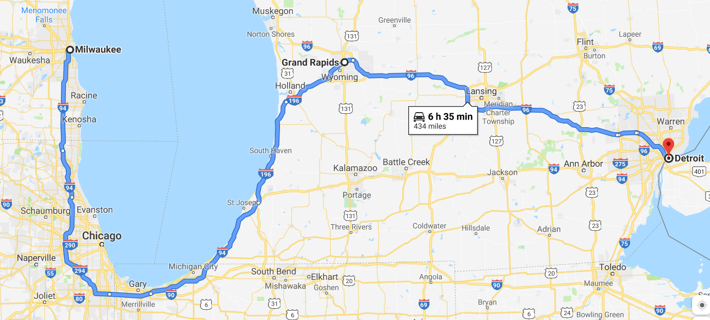
Spatial considerations
Mean distance
Euclidian vs real distance?
In km or travel time?
Spatial clustering
Of nodes
Of node attributes
Of edge extremities
Of traffic
Communities
Notes:
Euclidian distance might be useful in cases of airborne, vector-borne or unmeasured wildlife contacts transmission (proximal nodes with no contacts), but not if unrealistic in terms of impact of travel time. Or opposite, sometimes long spatial distance is relevant in very connected world (flight) two nodes can be more distance in space but closer in travel time than another pair.
Considering the impact of travel time on incubation period if undetected animal is shipped

Slide 52
Questions?
Contact: jpgo@ucdavis.edu, jerome.baron@sva.se
jpablo91.github.io

